Slide 1
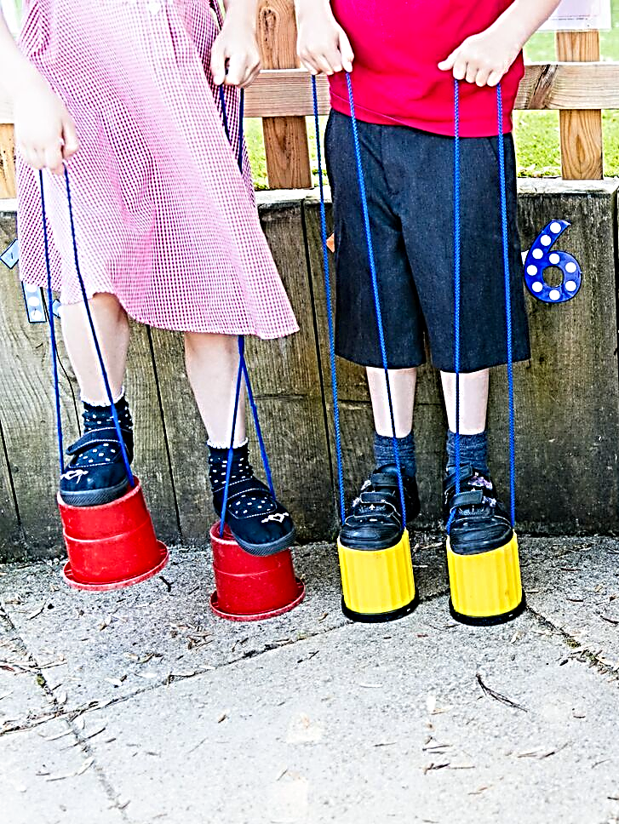


Welcomes you and your family to our
Year R OPEN DAY GUIDED TOURS
For September 2027 Entry
Please call to book a place
Wednesday 30th September – 9.45am
Monday 5th October – 11.15am
Friday 9th October – 11.15am
Monday 12th October – 10am
Tuesday 20th October – 11.15am
Thursday 5th November – 9.30am
Monday 9th November – 11.15am
Tuesday 17th November – 9.15am
Your opportunity to ask our leadership team any questions and see our thriving village school in action
01962
713358

